Slide 1
SERVLET

Slide 2
SERVLET
A servlet is a server-side software program, written in Java code, that handles messaging between a client and server.
The Java Servlet API defines a standard interface for the request and response messages so your servlets can be portable across platforms and across different Web application servers.
Servlets can respond to client requests by dynamically constructing a response that is sent back to the client.

Slide 3
SERVLET
A servlet can handle multiple requests concurrently and can synchronize requests.
Servlets can forward requests to other servers and servlets

Slide 4
SERVLET Working
A servlet runs inside a Java-enabled application server.
Application servers are a special kind of Web server; they extend the capabilities of a Web server to handle requests for servlets, and Web applications.
There is a distinct difference between a Web server and an application server.
The server itself loads, executes, and manages servlets.
The server uses a Java byte code interpreter to run Java programs; this is called the Java Virtual Machine(JVM).

Slide 5

SERVLET Working
The client sends a request to the server.
The server loads the servlet and creates a thread for the servlet process. (servlet is loaded upon the first request; it stays loaded until the server shuts down).
The server sends the request information to the servlet.
The servlet builds a response and passes it to the server.
The server sends the response back to the client.

Slide 6
SERVLET Usage
To accept form input and generate HTML Web pages dynamically.
As part of middle tiers to connecting to databases.
Applications such as online conferencing.
Act as active agents which share data with each other.
Servlets could be used for balancing load among servers which mirror the same content.

Slide 7
Servlet Features
PORTABILITY
Servlets are writing once, run anywhere (WORA) program, because we can develop a servlet on Windows machine running the tomcat server or any other server
Servlets are extremely portable so we can run on any platform.
So we can call servlets are platform independent

Slide 8
Servlet Features
POWERFUL
Servlets power full for: networking and URL access, multithreading, image manipulation, data compression, database connectivity, remote method invocation (RMI).
Servlets are also well suited for enabling client/server communication.
.

Slide 9
Servlet Features
EFFICIENCY
The servlet remains in the server‟s memory as a single object instance, when the servlet get loaded in the server.
The servlets can handled multiple concurrent requests as separate threads.

Slide 10
Servlet Features
SAFETY
As servlets are written in java, servlets inherit the strong type safety of java language.
Servlets can handle errors safely, due to Java's exception-handling mechanism.
INTEGRATION
Servlets are tightly integrated with the server.
Servlet can use the server to translate the file paths, perform logging, check authorization etc.

Slide 11
SERVLET Usage
PERFORMANCE
Due to interpreted nature of java, programs written in java are slow.
But the java servlets runs very fast.
These are due to the way servlets run on web server.
But in case of servlets initialization takes place first time it receives a request and remains in memory till times out or server shut downs.

Slide 12
Servlet Container
The servlet container is a part of a Web server or application server that provides the network services over which requests and responses are sent.
Servlets are managed by the servlet container, or servlet engine.
When the Webserver receives a request that is for a servlet, the request is passed to the servlet container.
The container makes sure the servlet is loaded and calls it.
Container is responsible for invoking, and destroying servlet components.
When the servlet is finished, the. the container reinitializes itself and returns control to the Webserver.

Slide 13
Servlet Container
A servlet container uses a Java Virtual Machine to run servlet code as requested by a web server.
The servlet container is also responsible for managing other aspects of the servlet lifecycle: user sessions, class loading, servlet contexts servlet configuration information, and temporary storage
Eg: Tomcat is the Servlet Engine or servlet container than handles servlet requests for Apache

Slide 14
Servlet API
The Java Servlet API is a set of classes and interfaces that define a standard interface between a Web client and a Web server.
The Servlet API consists of two packages, javax.servlet and javax.servlet.http.

Slide 15
The Javax.Servlet Package
The javax.servlet package contains a number of interfaces and classes that establish the framework in which servlets operate.

Slide 16
The Javax.Servlet Package Interface
Servlet :Declares life cycle methods for a servlet.
ServletConfig Allows servlets to get initialization parameters.
ServletContext Enables servlets to log events and access information about their environment.
ServletRequest Used to read data from a client request.
ServletResponse Used to write data to a client response.
SingleThreadModel Indicates that the servlet is thread safe

Slide 17
The Javax.Servlet Package Classes
GenericServlet Implements the Servlet and ServletConfig interfaces.
ServletInputStream Provides an input stream for reading requests from a client.
ServletOutputStream Provides an output stream for writing responses to a client.
ServletException Indicates a servlet error occurred.

Slide 18
The Javax.Servlet.Http Package
The javax.servlet.http package contains a number of interfaces and classes that are commonly used by servlet developers.
These classes and interfaces makes it easy to build servlets that work with HTTP requests and responses

Slide 19
The Javax.Servlet.Http Package Interface
HttpServletRequest Enables servlets to read data from an HTTP request.
HttpServletResponse Enables servlets to write data to an HTTP response.
HttpSession Allows session data to be read and written.
HttpSessionBindingListener Informs an object that it is bound to or unbound from a session

Slide 20
The Javax.Servlet.Http Package Classes
Cookie Allows state information to be stored on a client machine.
HttpServlet Provides methods to handle HTTP requests and responses.
HttpSessionEvent Encapsulates a session-changed event.
HttpSessionBindingEvent Indicates when a listener is bound to or unbound from a session value, or that a session attribute changed.

Slide 21
Life Cycle Of A Servlet
Three methods are central to the life cycle of a servlet.
These are init( ), service( ), and destroy( ).
They are implemented by every servlet and are invoked at specific times by the server

Slide 22
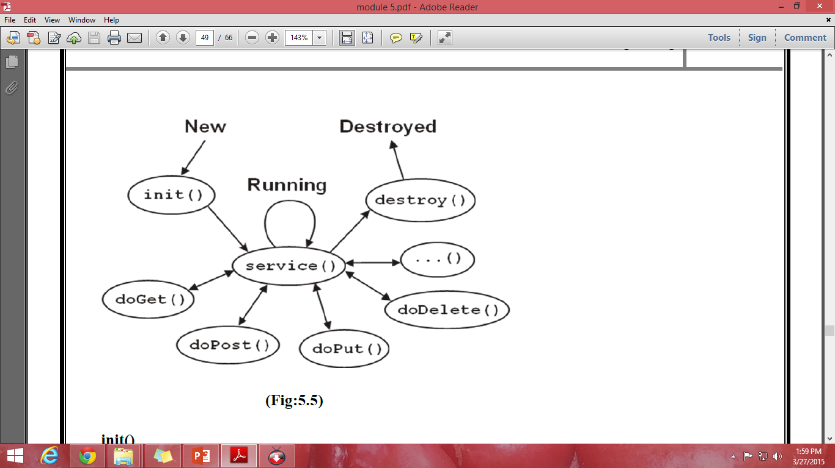
Life Cycle Of A Servlet

Slide 23
Life Cycle Of A Servlet
init()
When a server loads a servlet, it runs the servlet's init method.
Even though most servlets are run in multi-threaded servers, there are no concurrency issues during servlet initialization.
This is because the server calls the init method once, when it loads the servlet, and will not call it again unless it is reloading the servlet.
It is possible to pass initialization parameters to the servlet so it may configure itself.
After the init() method runs, the servlet container marks the servlet as available.

Slide 24
Life Cycle Of A Servlet
service()
After the server loads and initializes the servlet, the servlet is able to handle client requests. It processes them in its service method. Each client's request has its call to the service method. The service( ) method receives the client's request, checks the type of request (GET, POST, PUT, DELETE, TRACE, OPTION) and call the appropriate method: doGet, doPost, doPut, doDelete, doTrace, doOption. The service() method can have access to all the resources created in the init() method

Slide 25
Life Cycle Of A Servlet
destroy()
If the Servlet is no longer needed for servicing any request, the servlet container calls the destroy() method . Like the init() method this method is also called only once throughout the life cycle of the servlet. Calling the destroy() method indicates to the servlet container not to sent any request for service and the servlet releases all the resources associated with it. Java Virtual Machine claims for the memory associated with the resources for garbage collection

